Slide 1
CS 4476/6476 Project 2
Rushan Zhang
rzhang662@gatech.edu
rzhangbq@ust.hk
rzhang662
903849603
Discussed with Shuangyue Cheng (email: katcheng@gatech.edu)

Slide 2
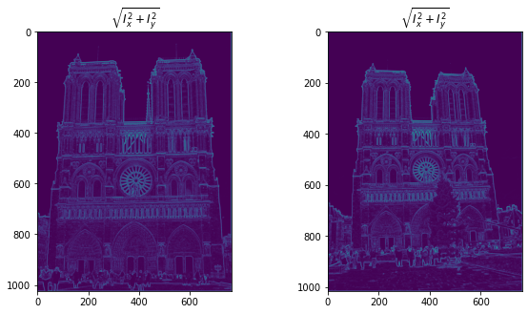
Part 1: Harris corner detector
[insert visualization of \sqrt(I_{x}² + I_{y}²) for Notre Dame image pair from proj2.ipynb here]
[Which areas have highest magnitude? Why?
The places where there is edges (e.g. the edges of the buildings.
This is because, these edges has a more abrupt change of lightness intensity. Therefore, the change of intensity per-unit-length, which is the magnitude of the gradient, is the highest.

Slide 3
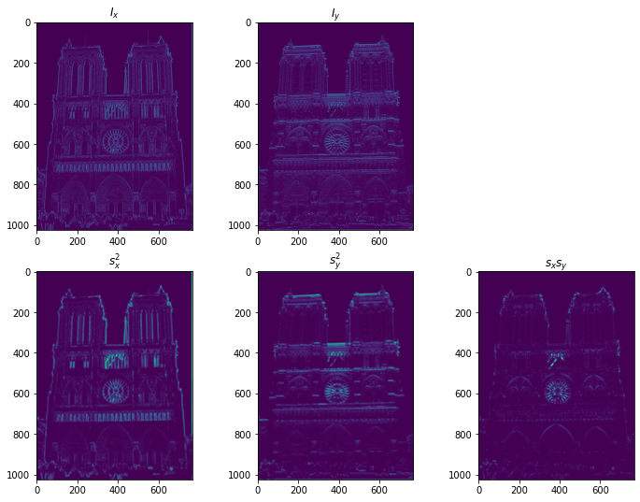
Part 1: Harris corner detector
[insert visualization of I_{x}, I_{y}, s_{x}², s_{y}², s_{x}s_{y} for Notre Dame image pair from proj2.ipynb here]

Slide 4
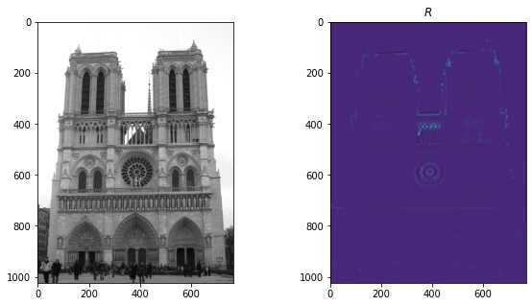
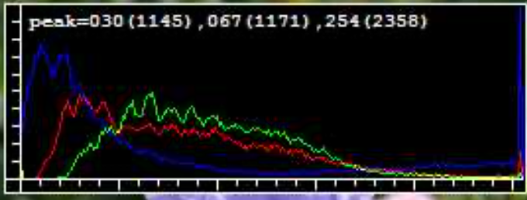
Part 1: Harris corner detector
[Are gradient features invariant to both additive shifts (brightness) and multiplicative gain (contrast)? Why or why not? See Szeliski Figure 3.2]
Gradient is invariant to brightness. This is because, even though the value of the points in the image are overall higher or lower, the change of the value does not become more or less abrupt.
The contrast will change the gradient of the images. For high contrast image, the bright part will become brighter and dark part will become darker. As a result, the change of brightness with space will become more abrupt. Therefore, the gradient will become higher.
e.g. histogram of high contrast image:
[insert visualization of corner response map of Notre Dame image from proj2.ipynb here]

Slide 5
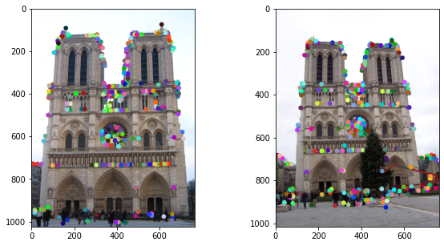
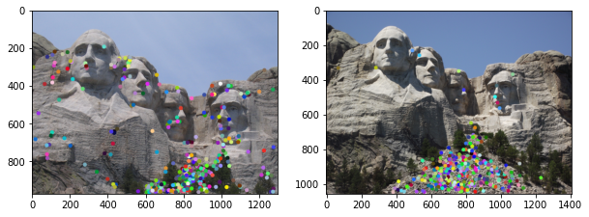
Part 1: Harris corner detector
[insert visualization of Notre Dame interest points from proj2.ipynb here]
[insert visualization of Mt. Rushmore interest points from proj2.ipynb here]

Slide 6
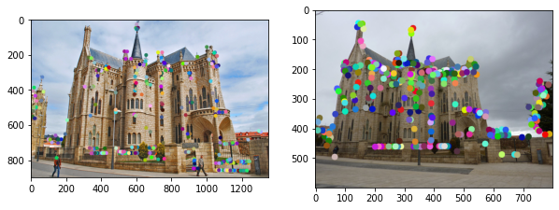
Part 1: Harris corner detector
[insert visualization of Gaudi interest points from proj2.ipynb here]
[What are the advantages and disadvantages of using maxpooling for non-maximum suppression (NMS)?]
Advantage:
Computationally effective: using built-in methods in numpy to compute, making the computation fast.
Simple to implement.
Can effectively remove duplicated non-maximum points to avoid the formation of point clusters.
Disadvantage:
It gives local maximum even if the local maximum point has a relatively low value. Therefore, an additional thresholding might be necessary.
The result is dependent on the kernel size, which could make it more complicated to during fine-tuning.

Slide 7
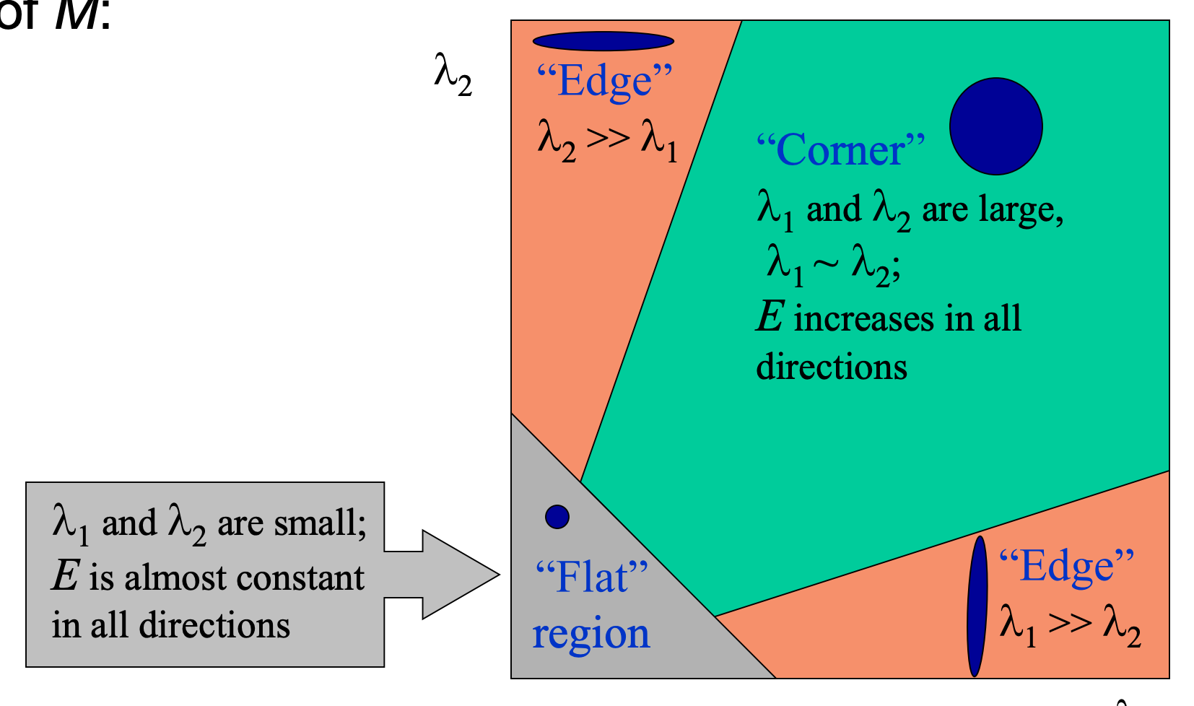
Part 1: Harris corner detector
[What is your intuition behind what makes the Harris corner detector effective?]
Utilizing gradient, which is partially invariant to brightness changes.
Utilizing a cornerness function to find points where both eigenvalues are large and both eigenvalues are similar, to ensure that the point we find is an edge, instead of an edge or a flat region:
Using NMS to find the local minimum,
so that duplicated non-maximum points are removed.
Corner itself is invariant to scaling, rotation and translation.
Computationally efficient: using linear-algebra methods to make the computation efficient.

Slide 8
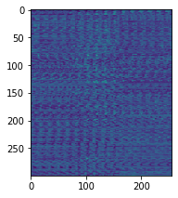
Part 2: Normalized patch feature descriptor
[insert visualization of normalized patch descriptor from proj2.ipynb here]
[Why aren't normalized patches a very good descriptor?]
Fixed window size, sensitive to scaling. (i.e. if we scale the image, the features chopped out from the fixed size window would be different).
Sensitive to rotation.
Sensitive to brightness changes (since it is directly comparing the brightness difference).
High time complexity: descriptor size is proportional to n^2, where n is the window size.

Slide 9
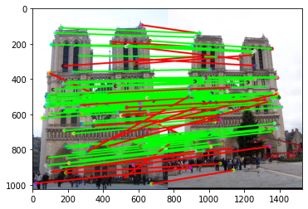
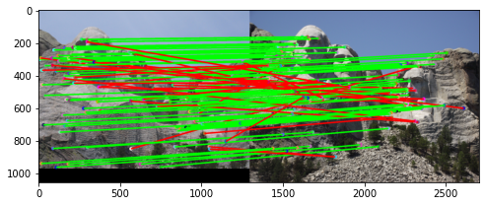
Part 3: Feature matching
[insert visualization of matches (with green/red lines for correct/incorrect correspondences) for Notre Dame image pair from proj2.ipynb here]
# matches (out of 100): 105
Accuracy: 0.752381
[insert visualization of matches for Mt. Rushmore image pair from proj2.ipynb here]
# matches: 111
Accuracy: 0.738739

Slide 10
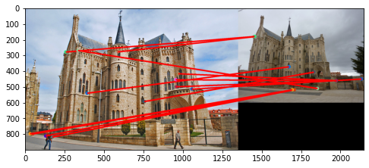
Part 3: Feature matching
[insert visualization of matches for Gaudi image pair from proj2.ipynb here]
# matches: 13
Accuracy: 0
[Describe your implementation of feature matching here]
Compute the L2 distance (i.e. sqrt((x1-x2)^2) of all the feature values.
For each feature in the first feature set, find the two closest features in the second feature set.
Compute the ratio of the distance from [the first closest] to [the second closest]. Save this ratio as the confidence.
If the ratio of feature is lower than a certain ratio (mine is 0.8), then set this feature and the closest feature in the second feature set as a matched pair.
Return the matched indexes and the confidences.

Slide 11
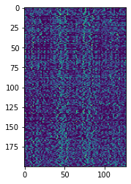
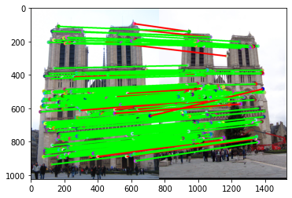
Part 4: SIFT feature descriptor
[insert visualization of SIFT feature descriptor from proj2.ipynb here]
[insert visualization of matches (with green/red lines for correct/incorrect correspondences) for Notre Dame image pair from proj2.ipynb here]
# matches (out of 100): 197
Accuracy: 0.934010

Slide 12
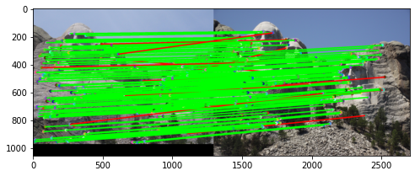
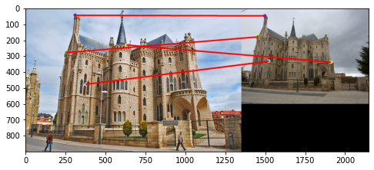
Part 4: SIFT feature descriptor
[insert visualization of matches for Mt. Rushmore image pair from proj2.ipynb here]
# matches: 181
Accuracy: 0.928177
[insert visualization of matches for Gaudiimage pair from proj2.ipynb here]
# matches: 4
Accuracy: 0

Slide 13
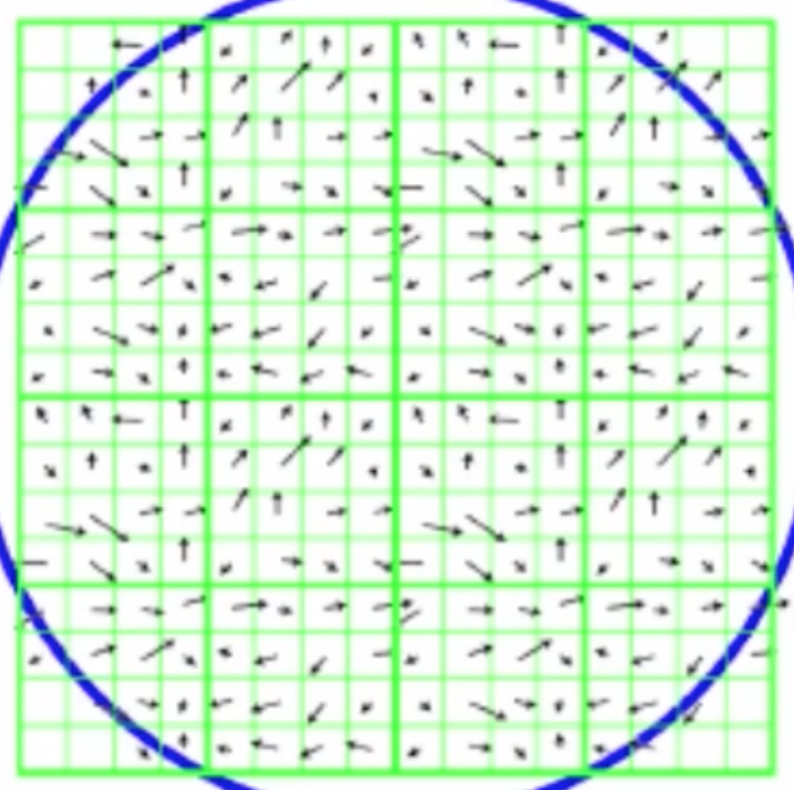
Part 4: SIFT feature descriptor
[Why are SIFT features better descriptors than the normalized patches?]
Using gradient to compute the descriptors, so that the result is more robust to the brightness or the lighting change (color, white balance) of the photos.
Normalizing and square-rooting the vectors, so that the result is more resistant to effect of illumination.
Smaller descriptor size (128 compared to 256), and decreasing orientation to 4 will not lead to significant degradation.
[Describe your implementation of SIFT feature descriptors here]
Compute the gradient of the image, transfer the gradient value into magnitude map and orientation map.
For each point obtained from Harris corner detector:
Get the surrounding 16*16 points as the window.
In each window, cut the window into 4*4 patches, compute the histogram of the orientation in 8 orientation regions, ranging from -pi to pi, with the magnitude as weighting.
Flatten the histogram in the 4*4 patches into a 4*4*8=128*1 array.
Normalize the flattened histogram and get the square-root of the histogram. Use this as the descriptor of the point.
Return the descriptor of all the points of interest.

Slide 14
Part 4: SIFT feature descriptor
[Why does our SIFT implementation perform worse on the given Gaudi image pair than the Notre Dame image and Mt. Rushmore pairs?]
Because the Gaudi image pair has a very large scaling difference.
The SIFT descriptor we are implementing is using a fixed window size (16*16 window around the point of interest). Therefore, if we scale the image, the contents in each window would also change. As a result, the content in each of the 4*4 patches would also change, so does the orientation histogram in each patch.
In sum, the SIFT we are implementing is not robust to scaling. Therefore, it cannot work well on the Gaudi image pair, which has a large scaling difference.

Slide 15

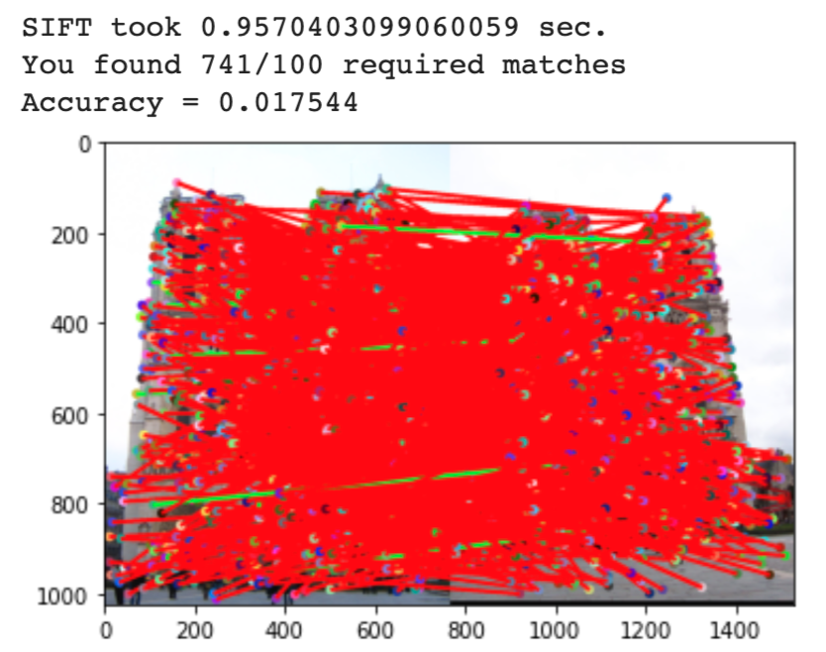
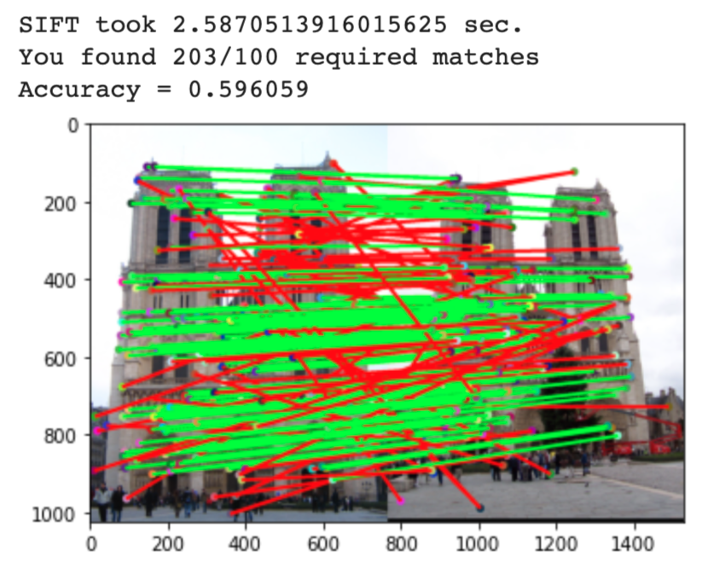
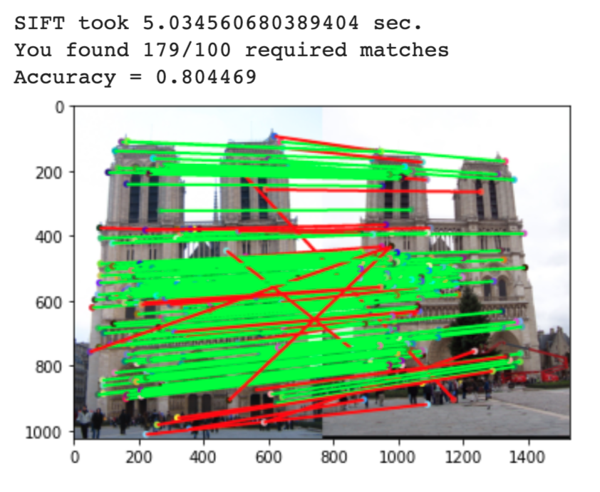
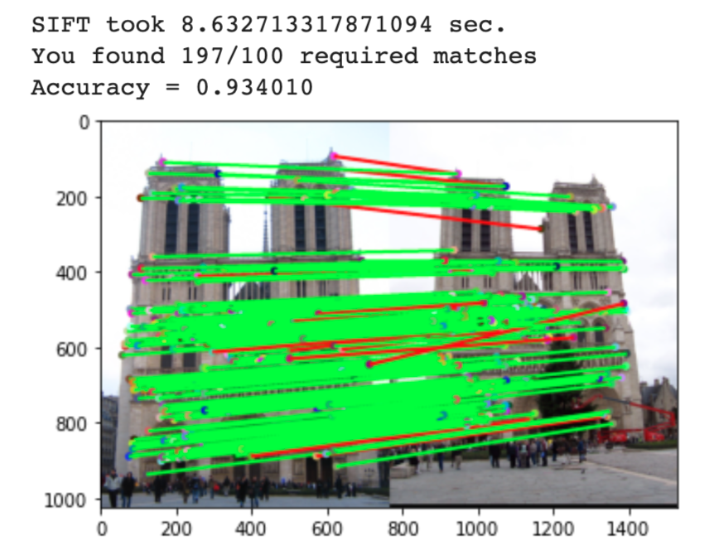
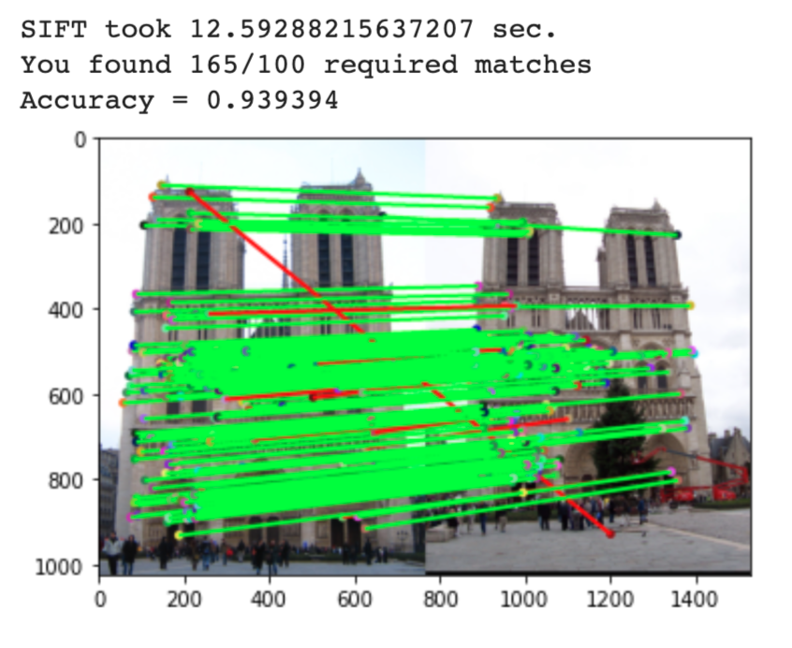
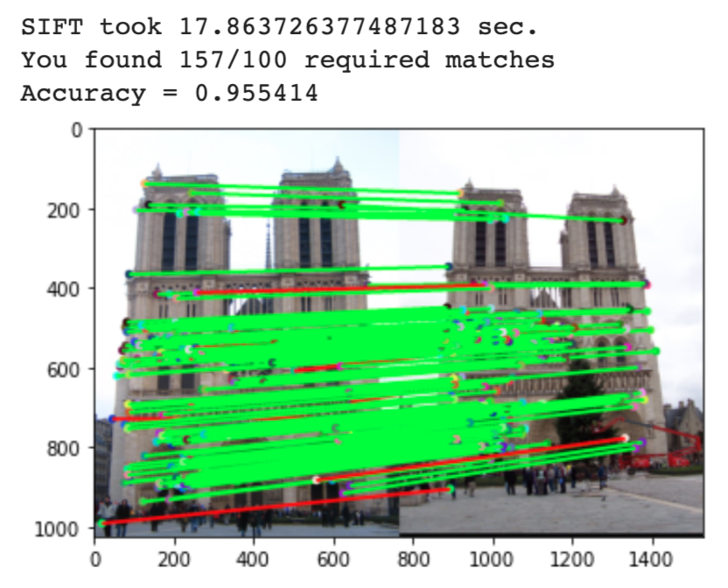
Part 5: SIFT Descriptor Exploration
These are the results from window size of 4, 8, 12; 16, 20, 24 (# orientations = 8, fixed patch size = 4*4, variating number of patches).
When the window size is smaller than 24*24, the accuracy increases as the window size increases. Among the above experiments, the window size of 24*24 gives the best result.
The change of window size also result in higher time complexity. The computational time is approximately proportional to n^2, where n is the window size.

Slide 16
Part 5: SIFT Descriptor Exploration
Describe the effects of changing the number of local cells in a window around a feature? Did different values have better performance?

Slide 17
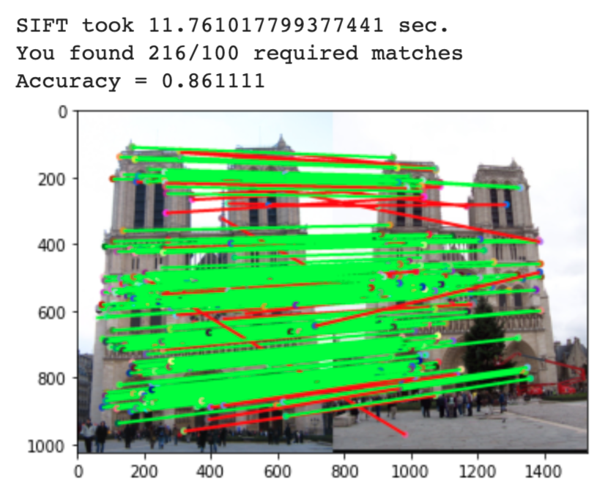
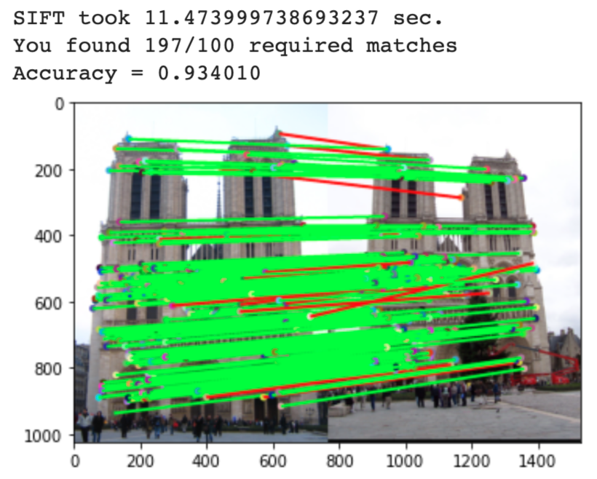
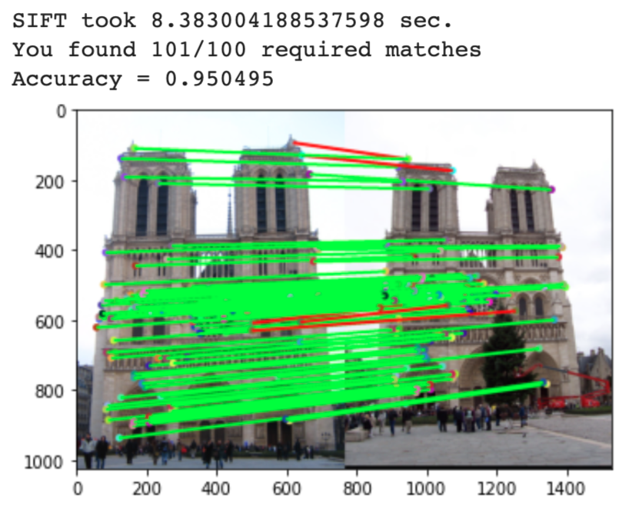
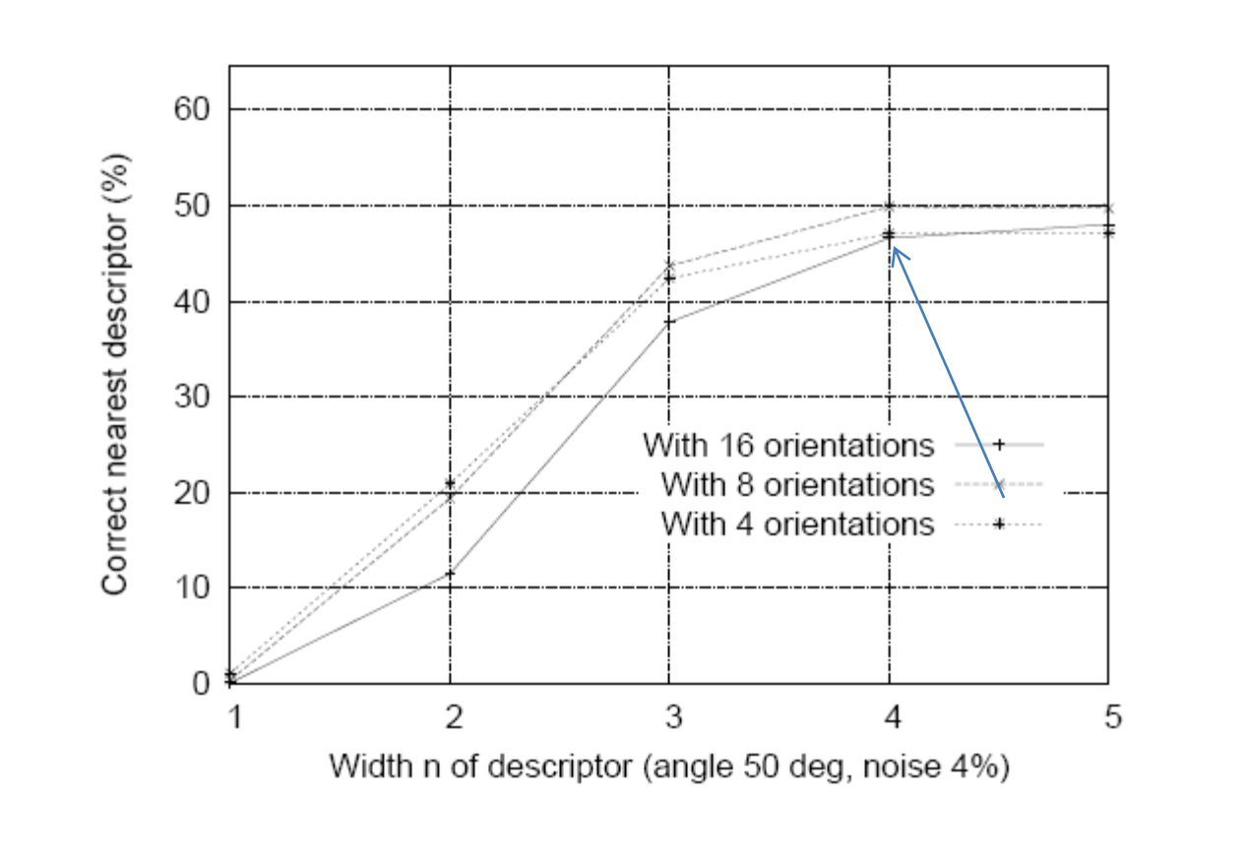
Part 5: SIFT Descriptor Exploration
Describe the effects of changing number of orientations (bins) per histogram. Did different values have better performance?
These are the results from orientation numbers of 4, 8, and 16 (the window size is 16*16, patch size is 4*4, number of patches is 4*4). The influence of change of orientation numbers is not as significant as the influence of changing the window size. The time complexity does not change as significantly as the window size. This is consistent with the result in the paper:

Slide 18
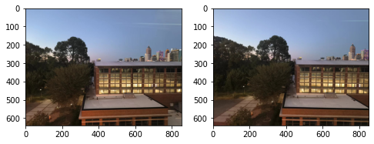
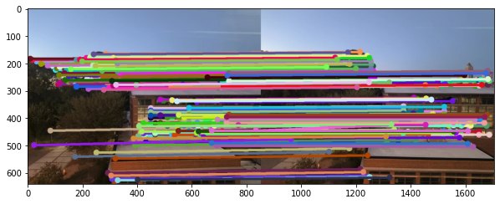
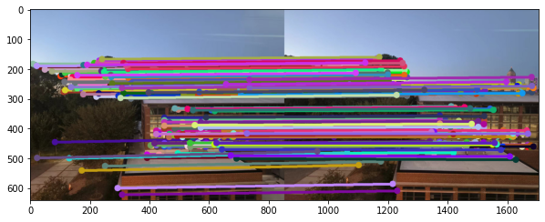
Part 5: SIFT Descriptor Exploration
[insert visualization of matches for your image pair from proj2.ipynb here]
original
normalized patches descriptor
Square-root SIFT descriptor

Slide 19
Part 5: SIFT Descriptor Exploration
[Discuss why you think your SIFT pipeline worked well or poorly for the given building. Are there any characteristics that make it difficult to correctly match features]?
The SIFT pipeline works well on my picture.
This is because, the pictures I fed into the SIFT pipeline avoid its weaknesses: my image pair does not have large rotational or scaling differences.
There are some reflecting light spots from the window through which I took the photos. However, it seems that this does not have much influence to the SIFT result. This might be because, these light spots are not strong enough and there are suppressed by the thresholding in the NMS.

Slide 20
Conclusion
[Why aren't our version of SIFT features rotation- or scale-invariant? What would you have to do to make them so?]
Because we are using a fixed window size with fixed orientation.
We might be able to implement a SIFT with a self-adapting window size, and we might have to rotate the window according to the main orientation of the point of interest.

